Slide 1
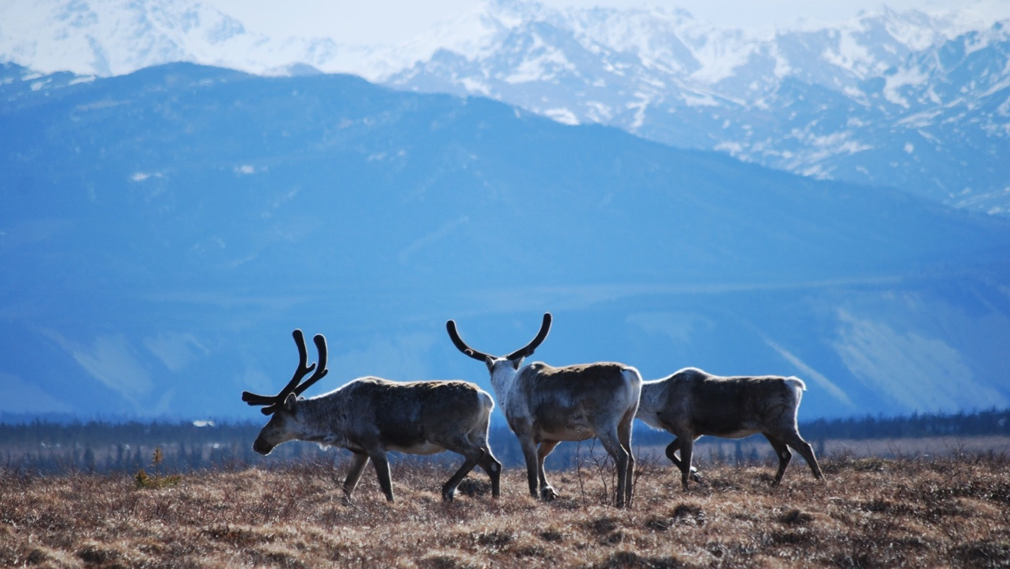
Arctic Boreal Vulnerability Experiment (ABoVE)
2019 ABoVE Airborne Flights
12 July 2019 (DOY 193)
AVIRIS-NG: Barrow – Atqasuk – North Slope
Charles Miller, Deputy Science Lead
Jet Propulsion Laboratory, California Institute of Technology
and the ABoVE Science Team For Hank Margolis, Mike Falkowski, Bruce Tagg, Jack Kaye
NASA HQ
2019

Slide 2
12 July 2019/DOY 193 Barrow – Atqasuk – North Slope
Daily Status:
AVIRIS-NG / Dynamic Aviation B-200 (N53W)
REPORT DATE: 12 July 2019
Current Status of Aircraft: GREEN
Current Status of AVIRIS: GREEN
Current Deployment Location: Fairbanks AK (PAFA)
Crew: M Drowley (PIC), C McCann, M Helmlinger, J Chapman
Science Planning: A Thorpe
Data Processing: W Olsen-Duvall
Instrument Manager: M Eastwood
Instrument PI: R Green
Science Lead: C Miller

Slide 3
12 July 2019/DOY 193 Barrow – Atqasuk – North Slope
Daily Summary:
Mostly clear with some high cirrus
Coastal fog and low clouds absent
Window fogged up on transit; landed in Barrow, refuled, cleared window and took off to obtain lines
Landed and refuled in Barrow 2nd time; proceeded to collect other North Slope lines in Colville Delta, along Dalton Hwy, Toolik Lake
NEON AOP also operating at Barrow today
NEON 7/12/19 report: With great weather along the coast of the Arctic Ocean, the remaining 43 lines were collected at Barrow, completing coverage there. While conditions seemed to be as good as they get, there were a few very thin layers of cirrus and the conditions were conservatively deemed yellow, although nearly green

Slide 4
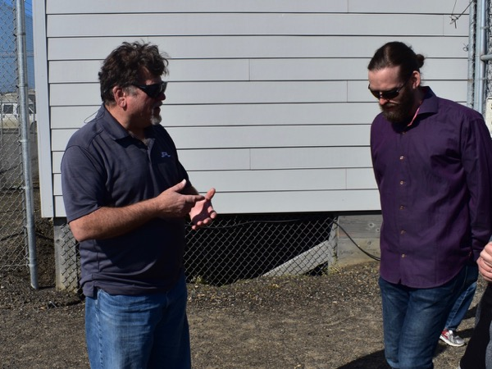
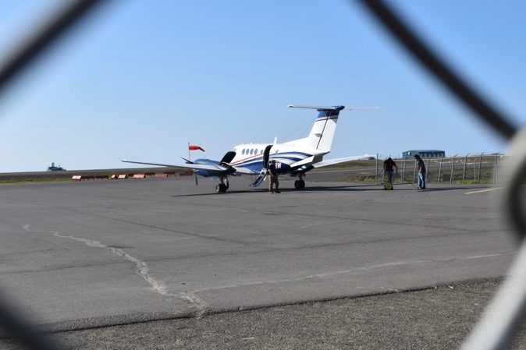
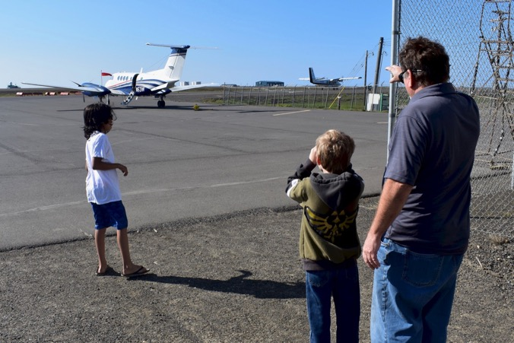
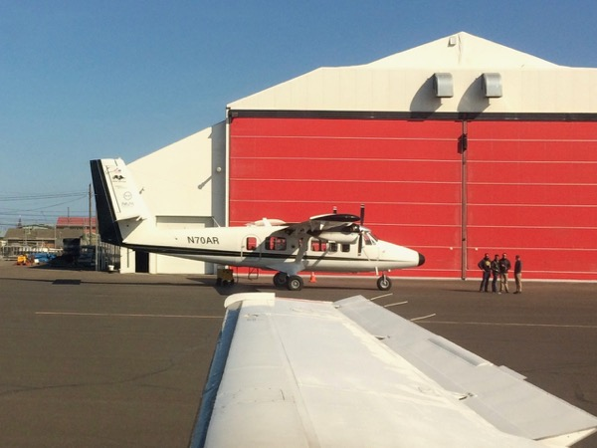
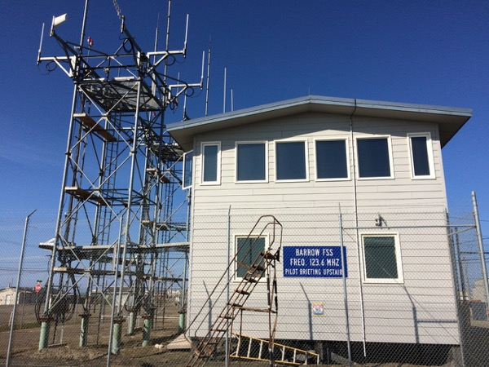
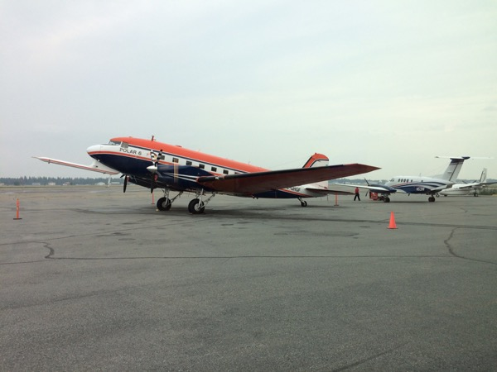
12 July 2019/DOY 193 Barrow – Atqasuk – North Slope
AWI POLAR-6 and N53W
In Fairbanks
Notes:
AVIRIS & NEON teams in Barrow; Visitors see AVIRIS

Slide 5
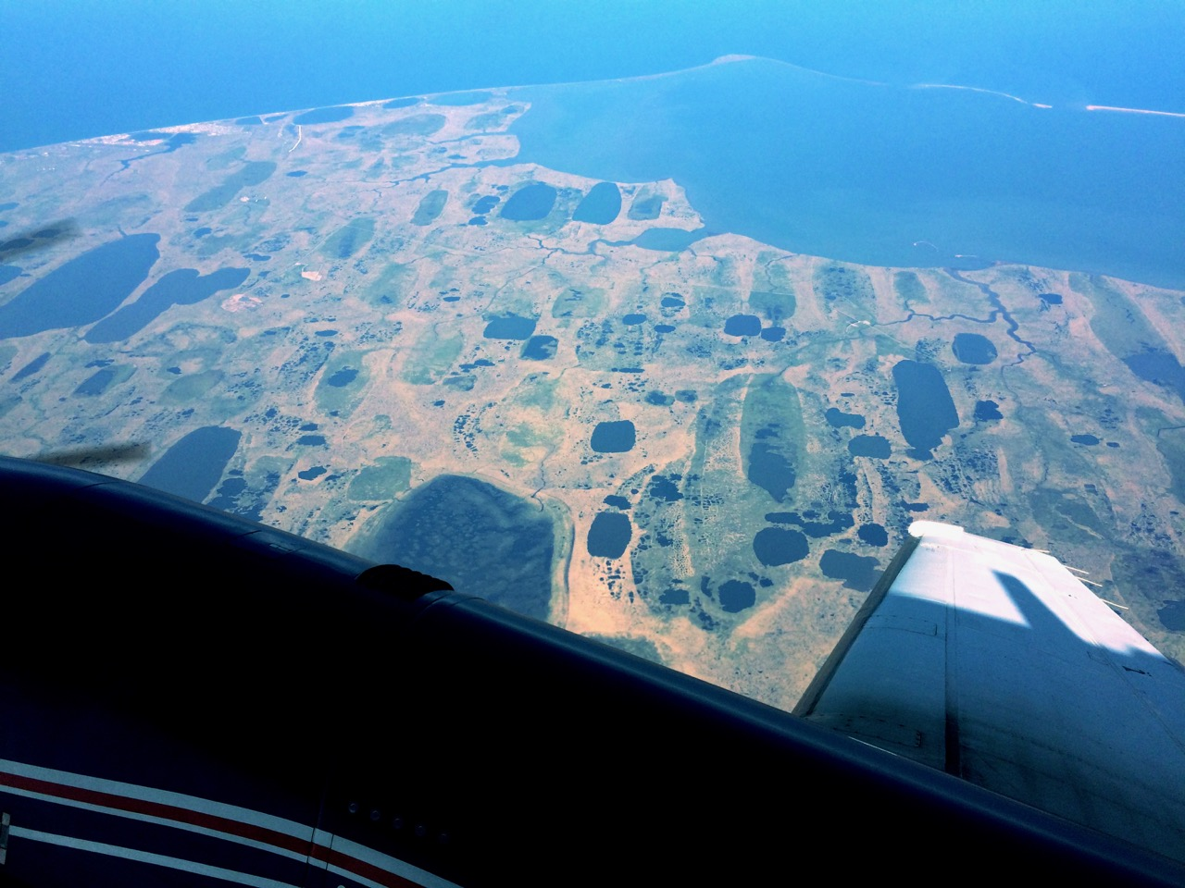
Notes:
Point Barrow

Slide 6
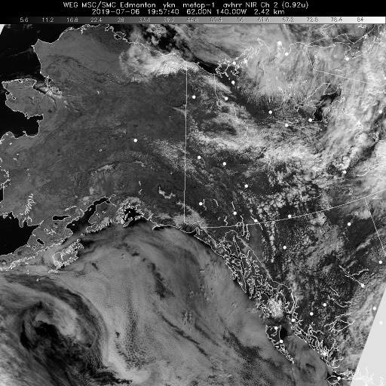
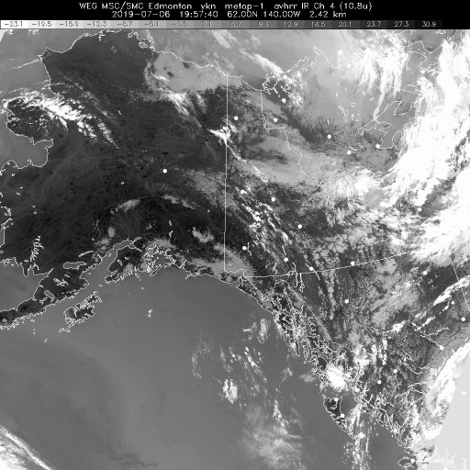
12 July 2019/DOY 193 Barrow – Atqasuk – North Slope
Vis 1957Z
IR 1957Z
Notes:
Some high cirrus, but no low level couds along the Ivotuk – Atqasuk – Barrow corridor. No coastal fog!

Slide 7
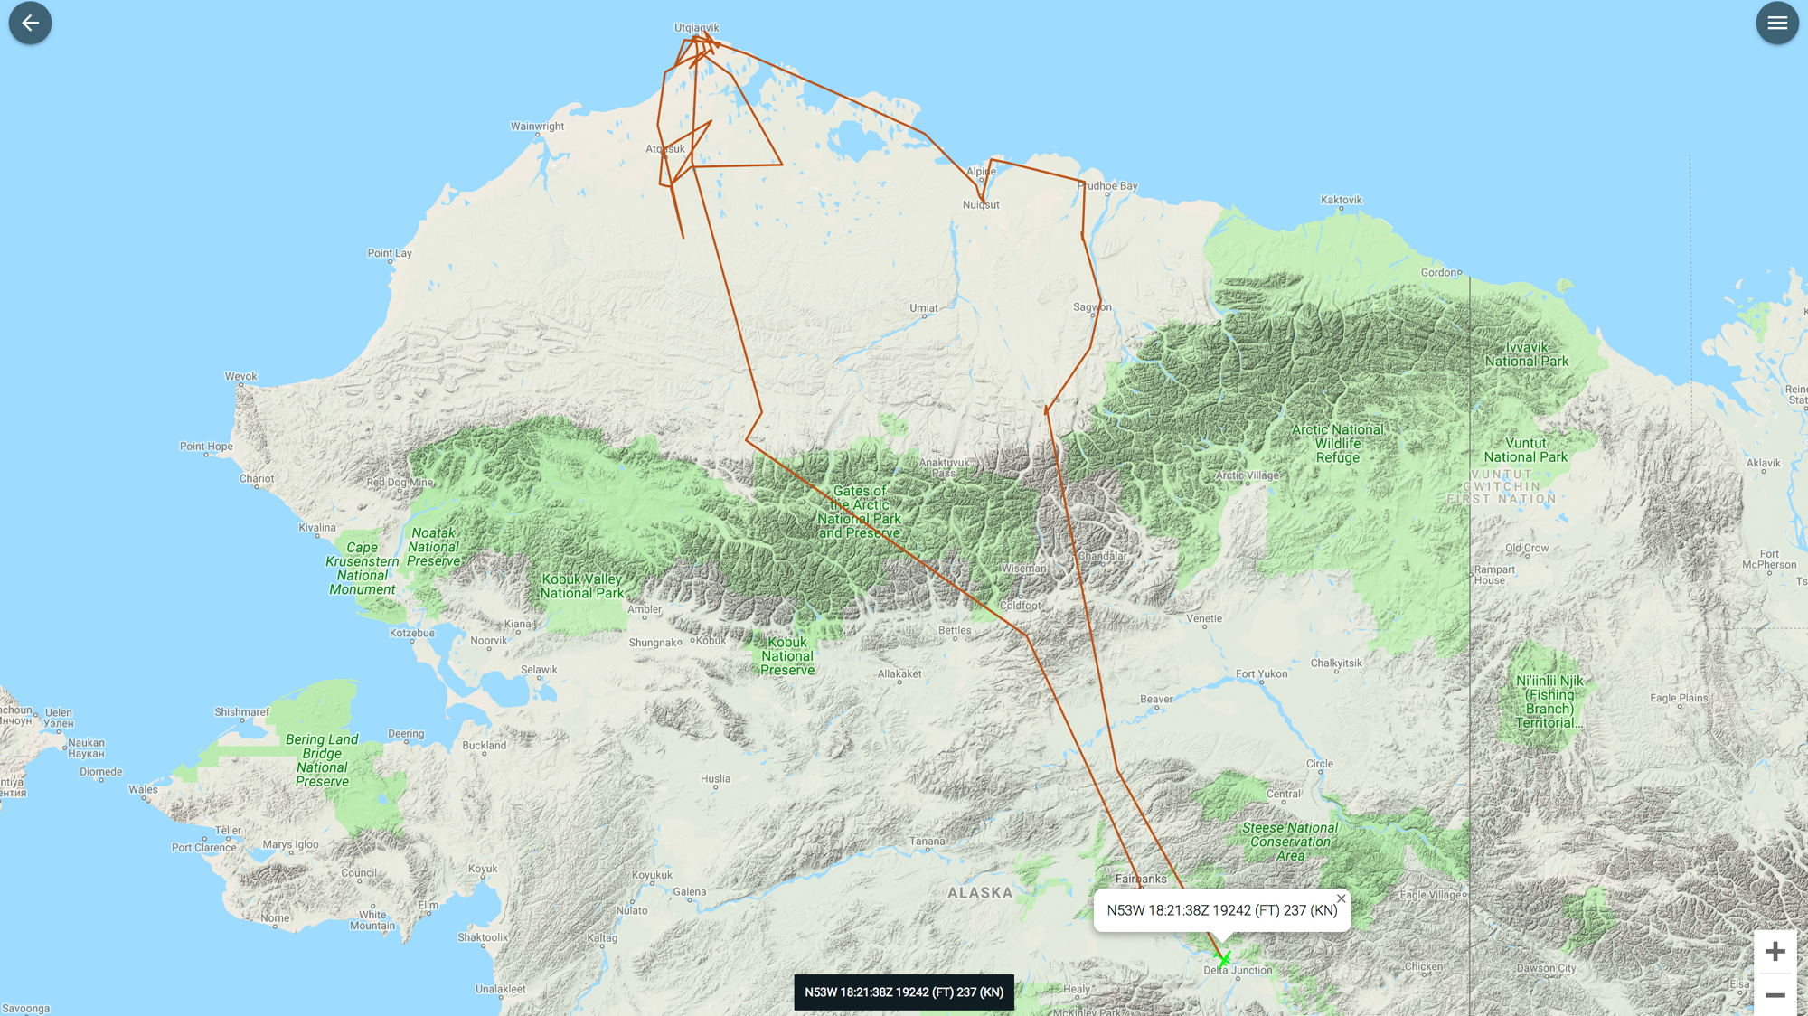
Leg 2
Leg 3
Leg 1
As-Flown Lines

Slide 8
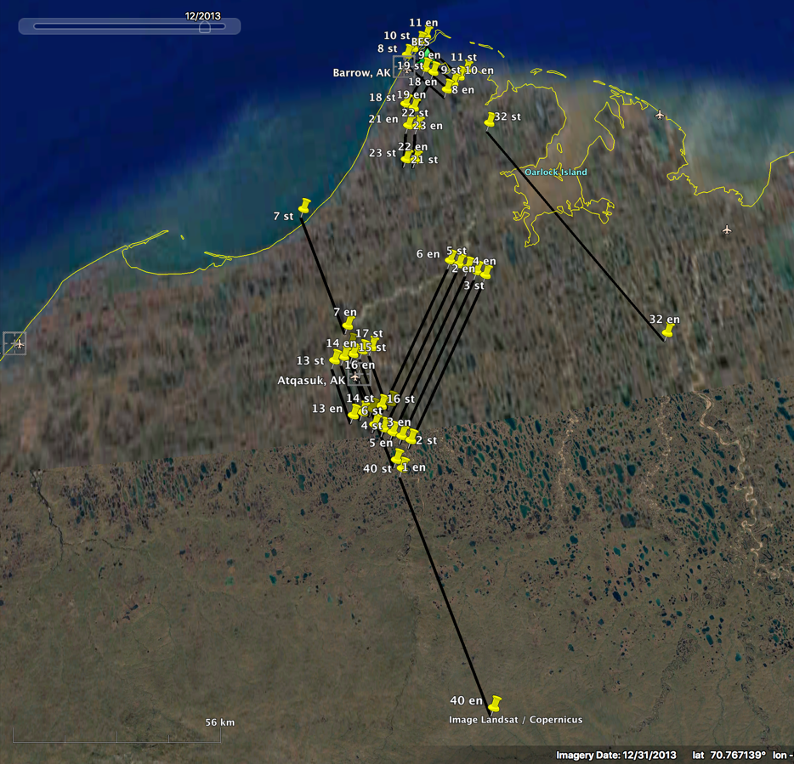
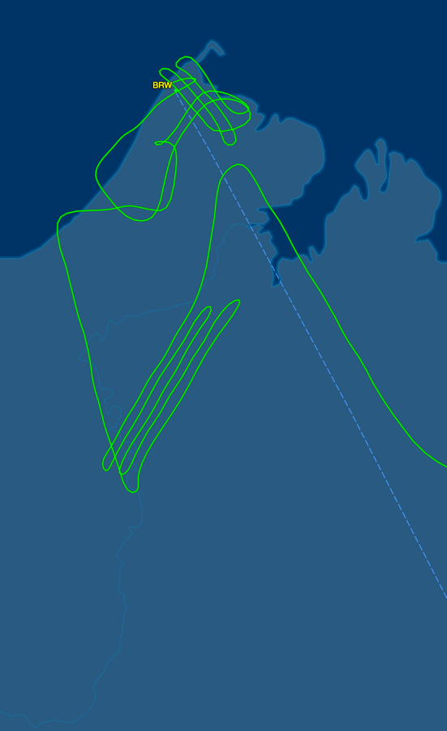
12 July 2019/DOY 193 Barrow – Atqasuk – North Slope
Update
Barrow - Atqasuk Area
Planned Flight Lines
Barrow - Atqasuk Area
As-Flown Lines

Slide 9
12 July 2019/DOY 193 Barrow – Atqasuk – North Slope
AVIRIS-NG Quick-look products
https://avirisng.jpl.nasa.gov/cgi/flights.cgi?step=view_flightlog&flight_id=ang20190712t
A. Line Barrow_L004_FL175 , ang20190712t211107_geo : Barrow grid
B. Line Barrow_L003_FL175 , ang20190712t211646_geo : Barrow grid
A
B
A. Amazing imagery of Admiralty Bay
B. Amazing imagery of Admiralty Bay
Notes:
7/19/19 Review
GREEN
GREEN

Slide 10
12 July 2019/DOY 193 Barrow – Atqasuk – North Slope
AVIRIS-NG Quick-look products
https://avirisng.jpl.nasa.gov/cgi/flights.cgi?step=view_flightlog&flight_id=ang20190712t
A. Line Barrow_L002_FL175 , ang20190712t212208_geo : Barrow grid
B. Line Barrow_L001_FL175 , ang20190712t212749_geo : Barrow grid
A
B
A. Brilliant imagery of Barrow area
B. Brilliant imagery
Notes:
7/19/19 Review
GREEN
GREEN

Slide 11
12 July 2019/DOY 193 Barrow – Atqasuk – North Slope
AVIRIS-NG Quick-look products
https://avirisng.jpl.nasa.gov/cgi/flights.cgi?step=view_flightlog&flight_id=ang20190712t
A. Line PipeLake_L001_FL175 , ang20190712t213356_geo : Pipeline Lake 1
B. Line PipeLake_L002_FL175 , ang20190712t213935_geo : Pipeline Lake 2
A
B
A. Well resolved images
B. Lakes and drained lakebeds
Notes:
7/19/19 Review
GREEN
GREEN

Slide 12
12 July 2019/DOY 193 Barrow – Atqasuk – North Slope
AVIRIS-NG Quick-look products
https://avirisng.jpl.nasa.gov/cgi/flights.cgi?step=view_flightlog&flight_id=ang20190712t
A. Line SukokLake_L002_FL175 , ang20190712t214601_geo : Sukok Lake
B. Line SukokLake_L001_FL175 , ang20190712t215039_geo : Sukok Lake
A
B
A. Swirling biota on Sukok Lake
B. Brilliant imagery
Notes:
7/19/19 Review
GREEN
GREEN

Slide 13
12 July 2019/DOY 193 Barrow – Atqasuk – North Slope
AVIRIS-NG Quick-look products
https://avirisng.jpl.nasa.gov/cgi/flights.cgi?step=view_flightlog&flight_id=ang20190712t
A. Line AVng_392A-392Z_FL175 , ang20190712t215625_geo : Tusikovak Lake
A
B
Area purposely left blank
A. Two very different swirling images of productivity SE of Barrow: lake vs inlet
Notes:
7/19/19 Review
GREEN
N/A

Slide 14
12 July 2019/DOY 193 Barrow – Atqasuk – North Slope
AVIRIS-NG Quick-look products
https://avirisng.jpl.nasa.gov/cgi/flights.cgi?step=view_flightlog&flight_id=ang20190712t
A. Line Atqasuk_L001_FL176 , ang20190712t221928_geo : Atqasuk grid
B. Line Atqasuk_L002_FL176 , ang20190712t223019_geo : Atqasuk grid
A
B
A. Mix of deep and shallow lakes and changing geomorphology NE of Atqasuk
B. Mix of deep and shallow lakes and changing geomorphology NE of Atqasuk
Notes:
7/19/19 Review
GREEN
GREEN

Slide 15
12 July 2019/DOY 193 Barrow – Atqasuk – North Slope
AVIRIS-NG Quick-look products
https://avirisng.jpl.nasa.gov/cgi/flights.cgi?step=view_flightlog&flight_id=ang20190712t
A. Line Atqasuk_L003_FL176 , ang20190712t224105_geo : Atqasuk grid
B. Line Atqasuk_L004_FL176 , 225208 : Atqasuk grid
A
B
Image in processing
A. Lakes and changing geomorphology NE of Atqasuk
B. In processing
Notes:
7/19/19 Review
GREEN
N/A

Slide 16
12 July 2019/DOY 193 Barrow – Atqasuk – North Slope
AVIRIS-NG Quick-look products
https://avirisng.jpl.nasa.gov/cgi/flights.cgi?step=view_flightlog&flight_id=ang20190712t
A. Line Atqasuk_L005_FL176 , ang20190712t230321_geo : Atqasuk grid
B. Line AVng_384A-384Z_FL175 , ang20190712t231624_geo : Atqasuk flux tower, CALM site
A
B
A. Meade River scenes near Atqasuk
B. Atqasuk flux tower near the village
Notes:
7/19/19 Review
GREEN
GREEN

Slide 17
12 July 2019/DOY 193 Barrow – Atqasuk – North Slope
AVIRIS-NG Quick-look products
https://avirisng.jpl.nasa.gov/cgi/flights.cgi?step=view_flightlog&flight_id=ang20190712t
A. Line CoffeeLake_L001_FL175 , ang20190712t232437_geo : Coffee Lake grid
B. Line CoffeeLake_L002_FL175 , ang20190712t233049_geo : Coffee Lake grid
A
B
A. Ebulition lakes near Atqasuk
B. Ebulition lakes near Atqasuk
Notes:
7/19/19 Review
GREEN
GREEN

Slide 18
12 July 2019/DOY 193 Barrow – Atqasuk – North Slope
AVIRIS-NG Quick-look products
https://avirisng.jpl.nasa.gov/cgi/flights.cgi?step=view_flightlog&flight_id=ang20190712t
A. Line CoffeeLake_L003_FL175 , ang20190712t233644_geo : Coffee Lake grid
B. Line CoffeeLake_L004_FL175 , ang20190712t234240_geo : Coffee Lake grid
A
B
A. Atqasuk village and neighboring lakes, many of which have known CH4 ebulition
B. Meade River and its many sand bars near Atqasuk
Notes:
7/19/19 Review
GREEN
GREEN

Slide 19
12 July 2019/DOY 193 Barrow – Atqasuk – North Slope
AVIRIS-NG Quick-look products
https://avirisng.jpl.nasa.gov/cgi/flights.cgi?step=view_flightlog&flight_id=ang20190712t
A. Line CoffeeLake_L005_FL175 , ang20190712t234843_geo : Coffee Lake grid
B. Line AVng_391A-391Z_FL177 , 235407_geo :
A
B
Image in processing
Area Purposely Left Blank
A. Loops of the Meade River near Atqasuk
B. In processing
Notes:
7/19/19 Review
GREEN
N/A

Slide 20
12 July 2019/DOY 193 Barrow – Atqasuk – North Slope
AVIRIS-NG Quick-look products
https://avirisng.jpl.nasa.gov/cgi/flights.cgi?step=view_flightlog&flight_id=ang20190713t
A. Line AVng_393A-393Z_FL175 , ang20190713t002123_geo : Transect: Arctic Ocean SE towards Atqasuk
B. Line AVng_391A-391Z_FL177 , 235407_geo :
A
B
Image in processing
Area Purposely Left Blank
A. Deep blue of the Arctic Ocean opposes the greening tundra SW of Barrow
B. In processing
Notes:
7/19/19 Review
GREEN
N/A

Slide 21
12 July 2019/DOY 193 Barrow – Atqasuk – North Slope
AVIRIS-NG Quick-look products
https://avirisng.jpl.nasa.gov/cgi/flights.cgi?step=view_flightlog&flight_id=ang20190713t
A. Line Macander_L001_FL175 , ang20190713t015946_geo : Colville Delta
B. Line Macander_L002_FL175 , ang20190713t020943_geo : Colville Delta
A
B
A. Arctic Ocean – Nuiqsut transect
B. Drilling pads and roads seen near the Colville Delta
Notes:
7/19/19 Review
GREEN
GREEN

Slide 22
12 July 2019/DOY 193 Barrow – Atqasuk – North Slope
AVIRIS-NG Quick-look products
https://avirisng.jpl.nasa.gov/cgi/flights.cgi?step=view_flightlog&flight_id=ang20190713t
A. Line AB_T01_L003_FL176 , ang20190713t023324_geo : Deadhorse – Dalton Highway
B. Line AB_T01_L002_FL178 , ang20190713t024201_geo : Dalton Highway
A
B
A. Deadhorse airport seen on the far left edge of this image
B. Dalton Highway, Sag River and pipeline imaged; this area frequently used for ABoVE ground truth
Notes:
7/19/19 Review
GREEN
GREEN

Slide 23
12 July 2019/DOY 193 Barrow – Atqasuk – North Slope
AVIRIS-NG Quick-look products
https://avirisng.jpl.nasa.gov/cgi/flights.cgi?step=view_flightlog&flight_id=ang20190713t
A. Line AVng_370A-370Z_FL182 , ang20190713t024938_geo : Deadhorse – Dalton Highway
B. Line AVng_371A-371Z_FL187 , ang20190713t025848_geo : Dalton Highway
A
B
A. Dalton Highway, Sag River and pipeline imaged; this area frequently used for ABoVE field measurements
B. Dalton Highway, Sag River and pipeline imaged; this area frequently used for ABoVE ground truth
Notes:
7/19/19 Review
GREEN
GREEN

Slide 24
12 July 2019/DOY 193 Barrow – Atqasuk – North Slope
AVIRIS-NG Quick-look products
https://avirisng.jpl.nasa.gov/cgi/flights.cgi?step=view_flightlog&flight_id=ang20190713t
A. Line AVng_372A-372Z_FL203 , ang20190713t030616_geo : Imnaviat Creek
B. Line AVng_373A-373Z_FL202 , ang20190713t031851_geo : Toolik Lake NEON box
A
B
A. Euskirchen flux tower transect
B. Partial coverage of the NEON box at Toolik Lake
Notes:
7/19/19 Review
GREEN
GREEN

Slide 25
Barrow Area Composite

Slide 26
Backup

Slide 27
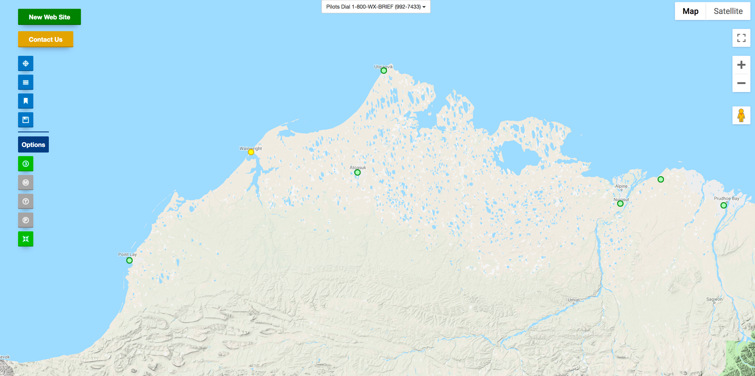
FAA Camera Locations

Slide 28
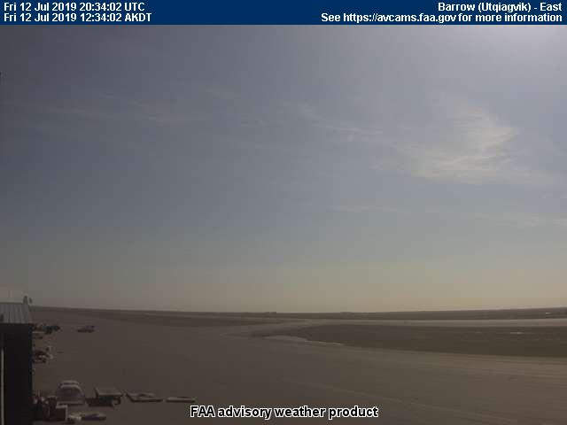
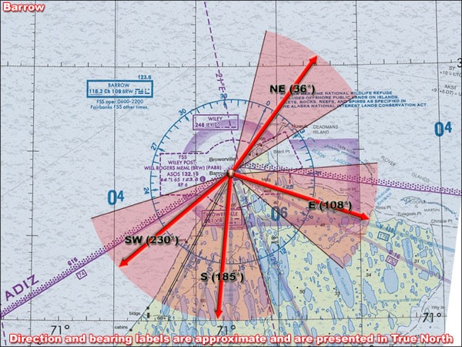
12 July 2019/DOY 193 Barrow – Atqasuk – North Slope
Barrow – 1330 AKDT/2130 UTC
Northeast
East
Southwest
South

Slide 29
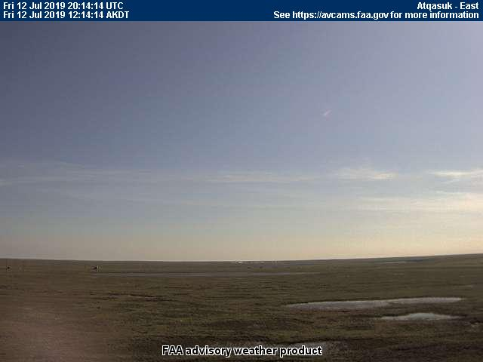
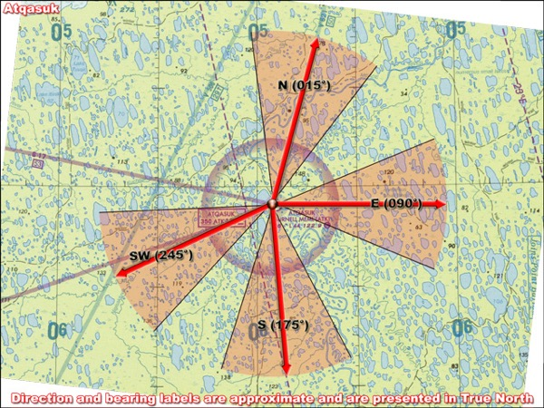
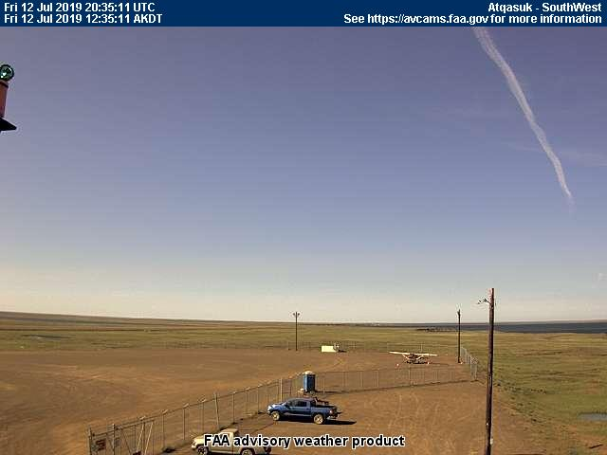
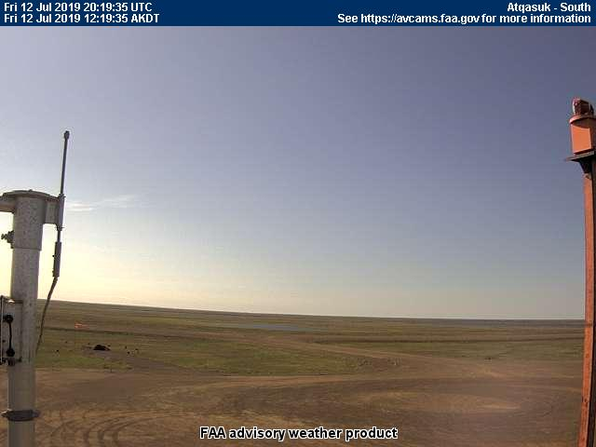
12 July 2019/DOY 193 Barrow – Atqasuk – North Slope
Atqasuk – 1235 AKDT/2035 UTC
North
East
Southwest
South

Slide 30
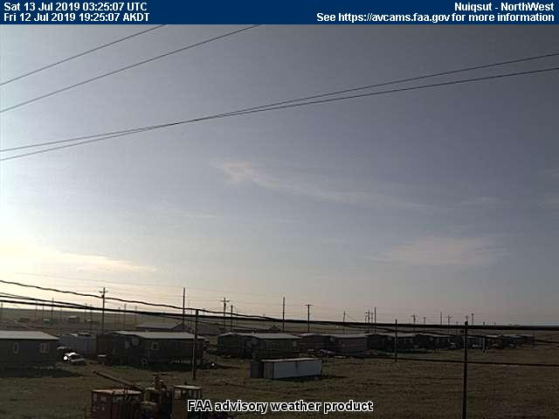
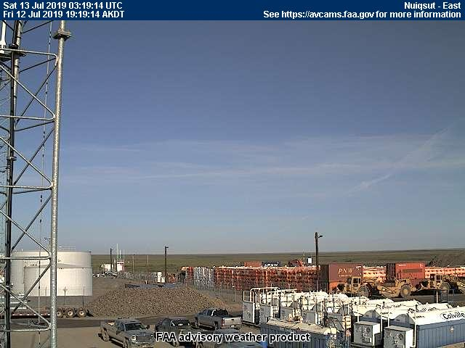
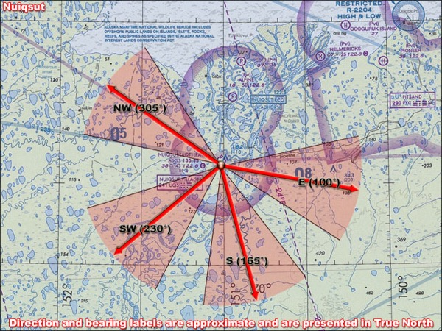
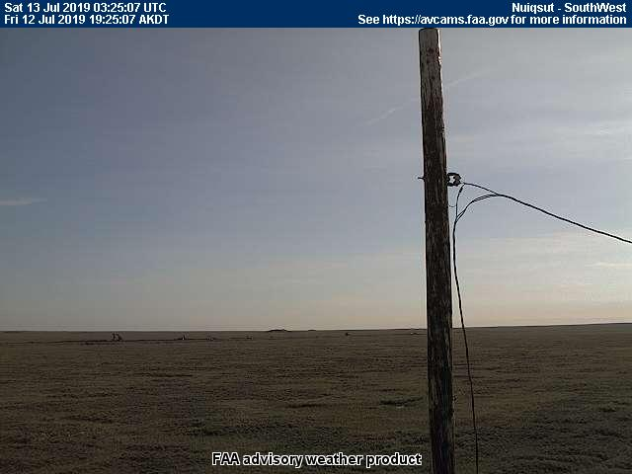
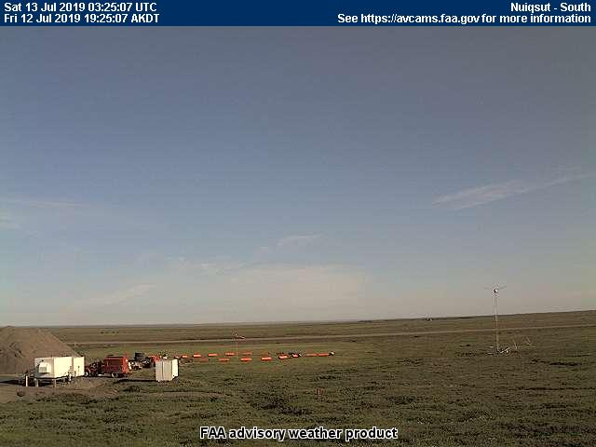
12 July 2019/DOY 193 Barrow – Atqasuk – North Slope
Nuiqsut – 1925 AKDT/0325 UTC
Northwest
East
Southwest
South

Slide 31
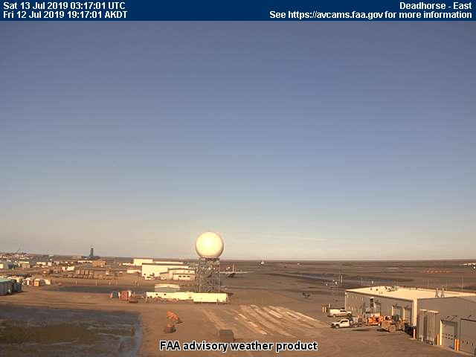
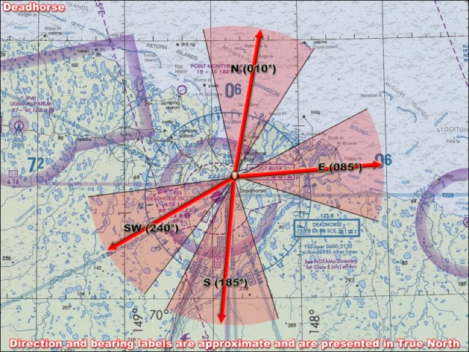
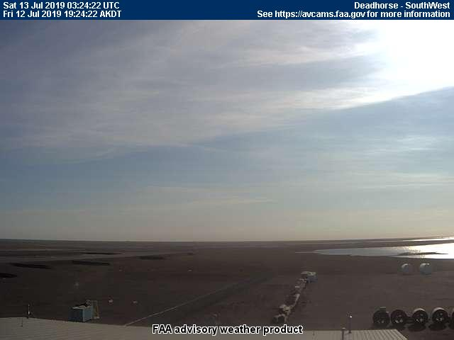
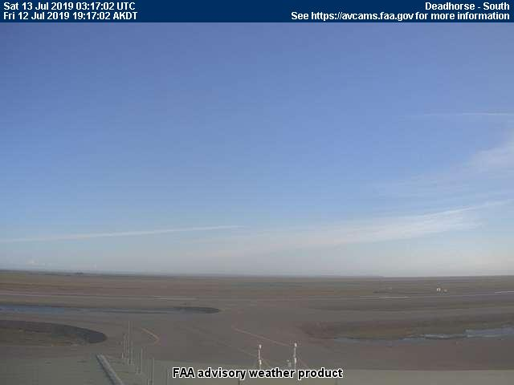
12 July 2019/DOY 193 Barrow – Atqasuk – North Slope
Deadhorse – 1924 AKDT/0324 UTC
North
East
Southwest
South

Slide 32
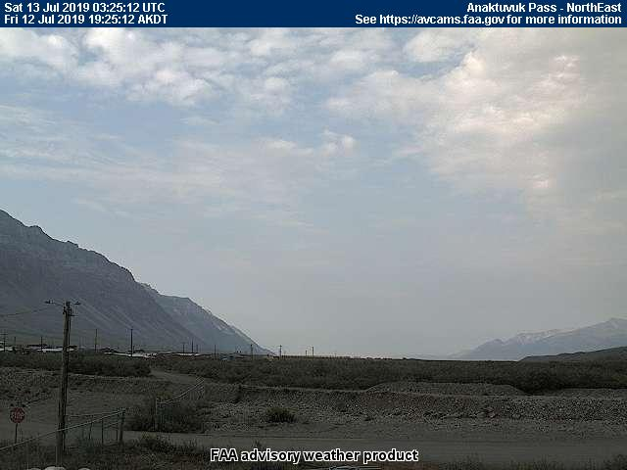
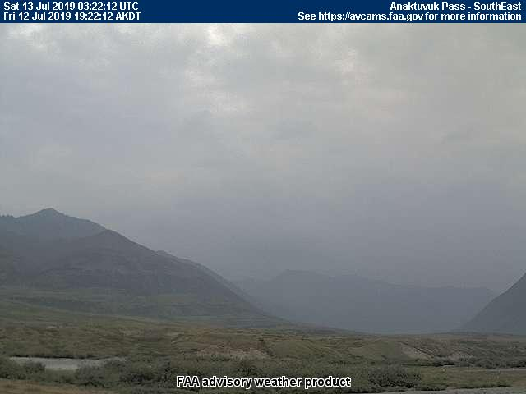
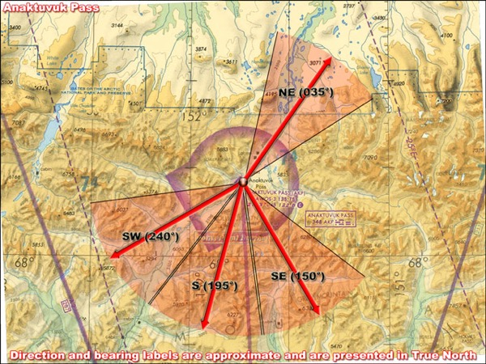
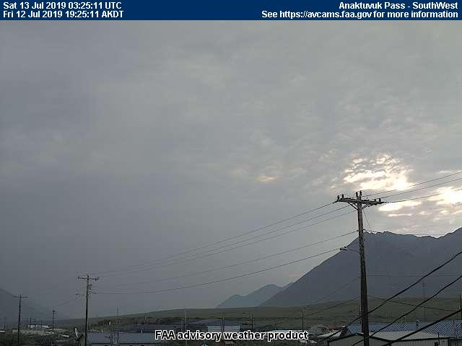
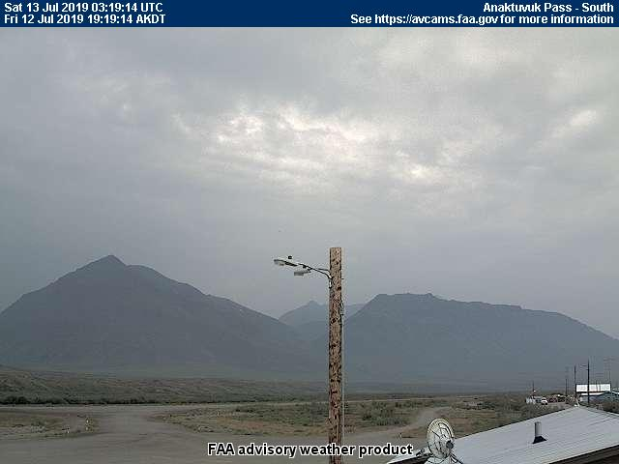
12 July 2019/DOY 193 Barrow – Atqasuk – North Slope
Anuktuvuk Pass – 1925 AKDT/0325 UTC
Northeast
Southeast
Southwest
South

